Slide 1

SUMMER TRAINING
On
MEASUREMENT OF DIELECTRIC CONSTANT OF CEREALS THROUGH MICROWAVES
At
INTERNATIONAL CENTRE FOR RADIO SCIENCE, JODHPUR
RAJASTHAN
Priya Saini
Electronics and Communication Engineering
4th year,7th semester
JIET School of Engg. & Tech. for Girls, Jodhpur
Rajasthan.

Slide 2
Measurement of dielectric constant of various cereals

Slide 3
CONTENTS:
Introduction to Microwaves
Applications of Microwaves
Microwave Remote sensing
Introduction to project
Measurement of Cereals
Mathematical formulations for dielectric constant measurement
Graphs for cereals for 3 states
Overview
Results
Conclusion

Slide 4

BRIEF ABOUT COMPANY
In January 1996 the formation of promoters group started and by June 1997 about 10 promoters signed for starting the International Centre for Radio Science (ICRS) as a registered society.
The ICRS was registered as society on 24th June 1997. The management committee was set up under the Chairmanship of Prof. O.P.N. Calla who earlier in May 1996 was invited by Promoters to become the First Director (Founder Director) of ICRS in the meeting held on 15th May 1996 at New Delhi.

Slide 5
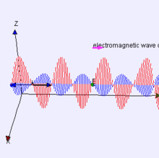
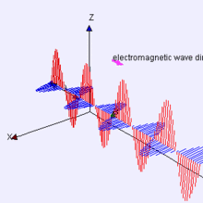
Electromagnetic waves
Electromagnetic waves can be imagined as a self-propagating transverse oscillating wave of electric and magnetic fields.
This 3D diagram shows a plane linearly polarized wave propagating from left to right
Note that the electric and magnetic fields in such a wave are in-phase with each other, reaching minima and maxima together.

Slide 6
ELECTROMAGNETIC SPECTRUM
The electromagnetic spectrum, in order of increasing frequency and decreasing wavelength, consists of radio waves, microwaves, infrared radiation, visible light, ultraviolet radiation, X-rays and gamma rays.
The eyes of various organisms sense a small and somewhat variable window of frequencies of EMR called the visible spectrum.
Microwaves form part of the EM spectrum with frequencies ranging from 300 MHz to 300 GHz and wavelengths of 1 m to 1 mm respectively.

Slide 7
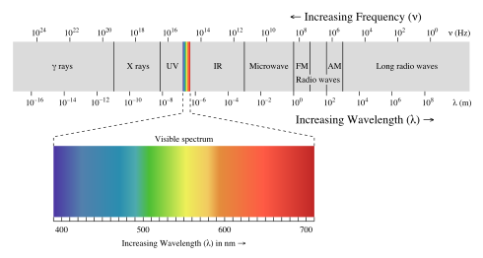
Microwaves can be further classified into three bands: the Ultra High Frequency (UHF) band with frequencies ranging from 300 MHz to 3 GHz,
the Super High Frequency (SHF) band with frequencies ranging from 3 to 30 GHz and
the Extremely High Frequency (EHF) band with frequencies ranging from 30 to 300 GHz.

Slide 8
Introduction to
Microwaves
Microwaves are short waves with wavelength ranging from one meter to one millimeter, or equivalently, with frequency between 0.3 GHz and 30 GHz.
Microwave bands designations:-
Band | Frequency Region | Origin of name
L | 1-2GHz. | Long wave
S | 2-4GHz. | Short wave
C | 4-8GHz. | Compromise between S and X
X | 8-12GHz. | Used in WW II for fire control, X for cross
Ku | 12-18GHz. | Kurz-under
K | 18-27GHz. | German Kurz (short)
Ka | 27-40GHz. | Kurz-above
Millimeter | 40-300GHz.

Slide 9
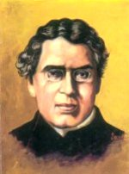
ORIGINATOR OF MICROWAVES
In the 1890s, the Indian physicist
Jagadish Chandra Bose extended Hertz’s experiment
using an improved apparatus at higher frequencies ranging from 60 to 120 GHz.
However, the rapid development of microwave technology came during World War II with the urgent need to improve radar detection of enemy aircraft and submarines and the invention of the high-power cavity magnetron.

Slide 10
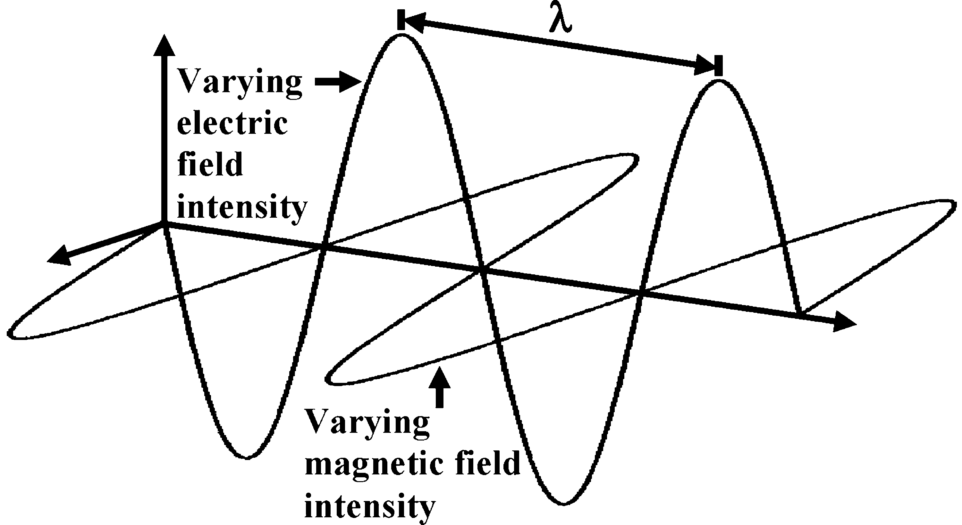
WHAT ARE MICROWAVES?
Microwaves and Electromagnetic Radiation:-Electromagnetic (EM) radiation is a form of energy radiated in the form of a wave traveling at the speed of light, comprising both electric and magnetic fields that oscillate at right angles to each other and in the direction of propagation.
The electromagnetic field is that part of space which contains and surrounds bodies in electric or magnetic conditions.
The propagation of an electro- magnetic wave is illustrated in Figure.

Slide 11
Microwave Heating
Applications of Microwaves:
Microwave Heating
Radio Detection and Ranging (Radar)
Medical Applications
Communications
Remote Sensing

Slide 12
Microwave Advantages
All Weather penetration Capability
Day Night Capability (independent of illumination of sun).
Penetration through Soil & Vegetation
Sensitivity to Moisture (in liquid or vapor forms).
As Frequency As wavelength penetration

Slide 13
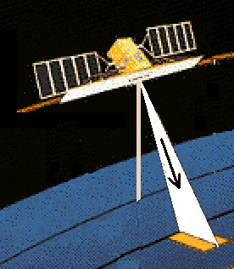
MICROWAVE REMOTE SENSING
Interactions between reflected, absorbed, and transmitted energy can be detected by remote sensing. The differences in cereals’s surface, textures, shapes or even how much the quantity of moisture is present in cereals, determine how much energy will be reflected, absorbed or transmitted. The relationship between reflected, absorbed and transmitted energy is used to determine spectral signatures of individual plants.

Slide 14
The basic principles of remote sensing with satellites and aircraft are similar to visual observations.
Energy in the form of light waves travels from the sun to Earth.
Light waves travel similarly to waves traveling across a lake.
The distance from the peak of one wave to the peak of the next wave is the wavelength.
Energy from sunlight is called the electromagnetic spectrum. The wavelengths used in most agricultural remote sensing applications cover only a small region of the
electromagnetic spectrum.
Wavelengths are measured in micrometers (µm) or
nanometers (nm)

Slide 15
MICROWAVE REMOTE SENSING-
On the basis of types of sensors
Passive MRS:
-Also called Radiometers
-Only can detect the radiated energy
-Used for natural materials
-Depends upon:
Polarization
Frequency
Angle of incidence and
Physical properties of surface

Slide 16
Active MRS:
-Uses scattering parameters
-For this surface roughness should be has relation to wavelength of sensor
-Can measure distance with high accuracy
-Capable to produce very high resolution imagery
-Depends upon:
Dielectric constant
Conductivity
Also on texture
Type of surface

Slide 17
FEATURES :-
Any natural material like water, soil, snow and cereals is characterized by two parameters; they are physical and electrical parameters.
A dielectric material is a substance that is a poor conductor of electricity, but an efficient supporter of electrostatic fields.
The lower the dielectric loss (the proportion of energy lost as heat), the more effective is a dielectric material.
The dielectric constant , the extent to which a substance concentrates the electrostatic lines of flux. It is also known as permittivity of the material.
Substances with a low dielectric constant include a perfect vacuum, dry air, and most pure, dry gases such as helium and nitrogen.

Slide 18
Interaction between Microwaves and Earth's Surface
When microwaves strike a surface, the proportion of energy scattered back to the sensor depends on many factors:
(1) Physical factors such as the dielectric constant of the surface materials which also depends strongly on the moisture content;
(2) Geometric factors such as surface roughness, slopes, orientation of the objects relative to the radar beam direction;
(3) The types of land cover (soil, vegetation or man-made objects).
(4) Microwave frequency, polarization and incident angle.

Slide 19
Material interaction with microwave
When microwaves are directed towards a material, part of the energy is reflected , part is transmitted through the surface, and of this latter quantity, part of it is absorbed.
The proportions of energy, which fall into these three categories, have been defined in terms of the dielectric properties.
The fundamental electrical property through which the interactions are described is the complex relative permittivity of the material, ε*. It is mathematically expressed as:
ε_{r}=ε’-jε’’
where:-
ε ’ =dielectric constant, and
ε" = dielectric loss factor.

Slide 20
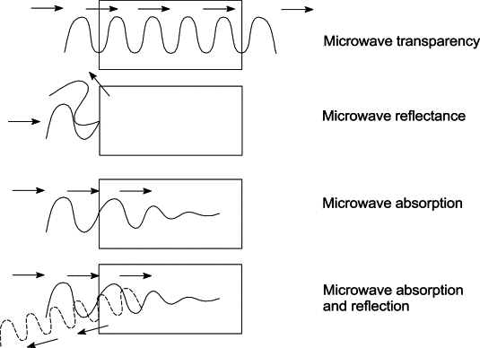
Dielectric constant of any material is defined as “The ability of a material to absorb, emit, scatter and reflect a portion of EM wave.”
It depends upon the physical properties of material including shape and size of the sample, humidity, temperature, frequency and field of measurement.

Slide 21
GLANCE ON PROJECT
Remote sensing observations have been used for identification and monitoring of agricultural targets since the late 19 century.
The use of radar sensors for agricultural applications has been intensively studied since 1970.
Our project is totally devoted to last person of the society.
This provides a revolutionary change in cropping field of cereals.
In cropping of cereals it helps to get better results In farming.

Slide 22
METHODOLOGY FOR DIELECTRIC MEASUREMENT
The choice of method of measurement depend upon many factors such as the physical properties including shape and size of the sample, temperature ,humidity and field of measurement.
There are basically four methods of dielectric constant measurement at microwave frequencies .They are as follows :-
Transmission Line Method
Cavity Method
Free Space Method
          Waveguide Cell Method

Slide 23
Waveguide Cell Method
This method too gives data for a wide range ranging from 500MHz-110GHz. Using waveguide of different dimension.
Sample preparation is required.
Easy to use and its analysis can be done manually as well as with the help of software.
Proper design make it possible to use for solids, liquid and semi-liquids.
Time consuming method but very much authentic.

Slide 24
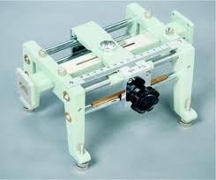
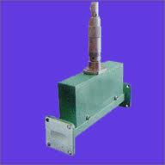
Equipments cost is very low.
Accuracy lies between that of Spectrum analyzer and cavity method.
Limited skill is necessary.
Slotted line section Variable Attenuator

Slide 25
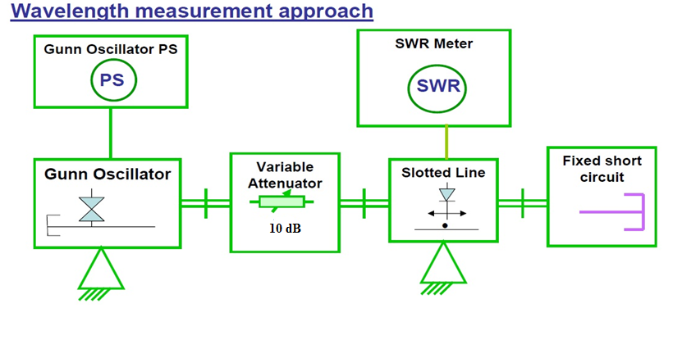
BLOCK DIAGRAM FOR EXPERIMENTAL SETUP

Slide 26
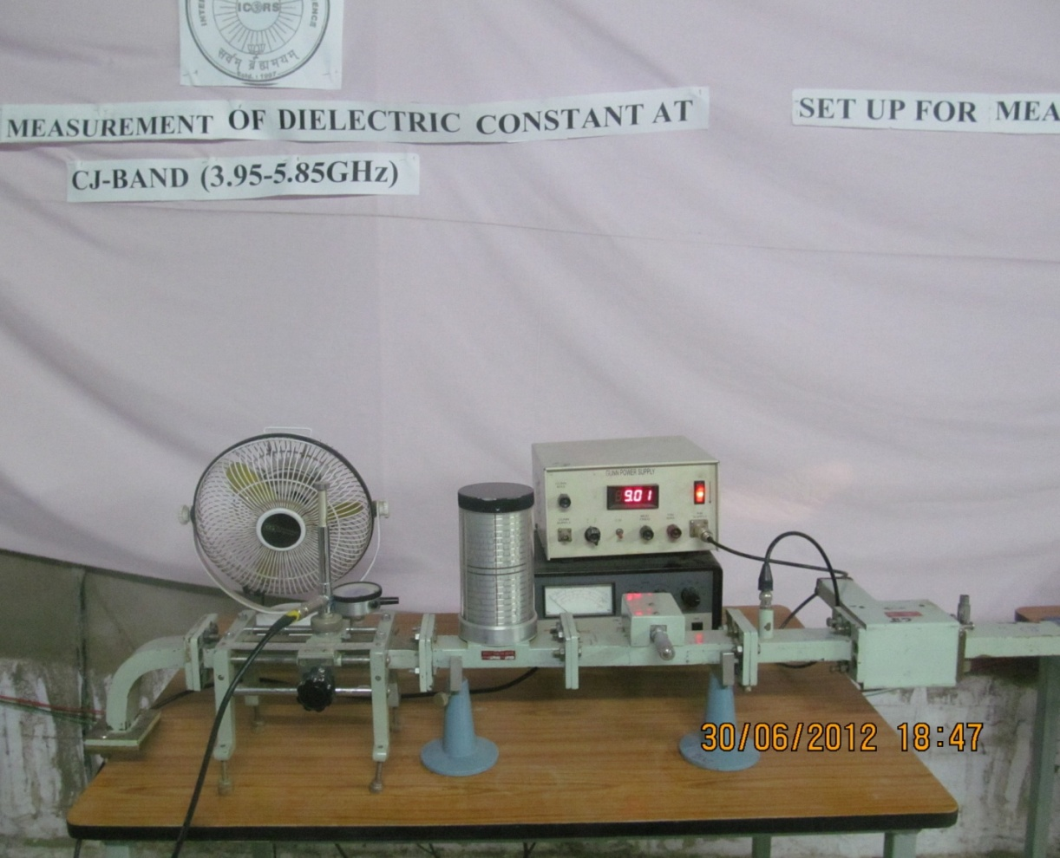
MEASUREMENT FOR CEREALS
Actual Bench Setup for experiment

Slide 27
Methodology
Dielectric Constant:- In lossy materials, the conductivity is zero, i.e. the material is a poor conductor of electricity and the material is called dielectric material.
The dielectric constant can be defined as the extent to which the substance concentrates the electrostatic lines of flux. It specifies the relative permittivity of a material.
Relative permittivity is the permittivity of the material with respect to free space.
Relative permittivity (ε_{r})=permittivity of material (ε) / permittivity of free space (ε_{o})

Slide 28
Preparation of sample
Preliminary sample- Firstly weighted the empty cell.
Then after take natural sample of each and weighed them before taking measurements.
Oven dried sample- The samples were firstly oven dried at 110˚C for about 30 minutes.
Equal amount of oven dried samples were taken for measurements.
Take weight of each sample after oven dried process.

Slide 29
Saturated sample-
The measured quantity of water was added to the samples using dropper.
Take weight of each sample after saturation.
The samples were kept for 24 hours for homogeneous mixing and final settlement.
The dielectric constant of the samples was then measured at different gravimetric moisture at successive time intervals.
Weighted each sample also at different gravimetric moisture at successive time intervals.

Slide 30
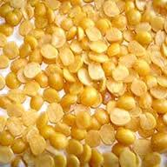
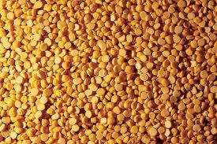
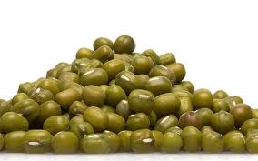
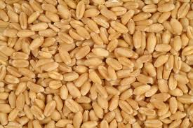
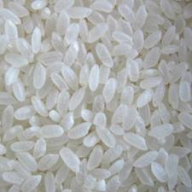
Description About Samples
In our project we have taken VSWR measurement and dielectric measurement for 5 samples namely :-
Chana dal
Arhar dal
Moong dal
Wheat and samples
Rice

Slide 31
Analysis of the data
For this experiments the whole procedure is followed for microwave equipments used in microwave bench setup.
Keep the control knobs of VSWR meter as below:
  Range dB - 50 dB position
  Input switch - low impedance
  Meter switch - normal position
  Gain (coarse and fine) - full clockwise
VSWR METER

Slide 32
4.Keep the control knob of the power supply as under:
  Meter switch - (V)
  Gunn bias knob - full anti clockwise
  Pin bias knob - full anti clockwise
  Switch no. 4 - INT position
  Pin mod frequency - any position
GUNN POWER SUPPLY

Slide 33
5.Set the micrometer of Gunn oscillator for required frequency of operation.
6.Connect the cord of cooling fan to the socket provided at the back of Gunn power supply.
7.Switch on the Gunn power supply and VSWR meter.
GUNN
OSCILLATOR

Slide 34
8.Increase the Gunn bias control knob on 10V maximum position.
9.Rotate pin bias knob to around maximum position.
10.Tune the maximum output in the VSWR meter through frequency control knob of modulation and tunable probe.
11.If necessary change the range dB switch of VSWR meter to higher or lower dB position.

Slide 35
VSWR measurement using SAMPLES
With no sample in short circuited line, find voltage minima position with the help of slotted section and tunable probe. let it be D_{R.}
Measure the guide wavelength (λ_{g} ) by measuring the distance between two adjacent minima in the slotted line.
Remove the short circuit ,insert the sample in the short circuited line such that it surface is properly leveled and fitted.
Measure D, the position of minima in the slotted line with respect to the reference plane.
Measure the VSWR in the meter and from the slotted line as discussed in the previous slide.

Slide 36
Mathematical Formulations for dielectric measurement:
The relevant equations used for determining the dielectric constant in the given frequencies are as follows:-
k=2Π/λ_{g} (1)
where,
k= Propagation constant
λg = Guide wavelength
φ= 2k (D-Dr-lε) (2)
Where,
φ = Phase angle
D = First voltage minima of sample
Dr = First voltage minima when waveguide is short circuited
l_{ε}= length of sample=0.694 cm(depth of waveguide cell)

Slide 37
|Г| =(r-1)/(r+1) (3)
Where,
|Г| =reflection coefficient
r =voltage standing wave ratio (vswr)
Complex transcendental equations:-
K=(-2|Г|sinφ)/ (kl_{ε}(1+|Г|²+2|Г|cosφ)) (4)
A=(|Г|²-1)/(k l_{ε}(1+|Г|²+2|Г|cosφ)) (5)
Now, solve for X in the real transcendental equation, using the two sets of data to determine X’
R= (A X’²) / (tan X’- X’ (1+tan² X’)) (6)
K’ = (R tan h R (1+tan² X’) + X’ tan X’ (1- tan h²R))/
((R²+X’²) (1+ tan² R tan² X’)) (7)
If K and K’ are almost identical, the values of X’ and R calculated are acceptable; if not, this method of solution does not apply.

Slide 38
T= (R²+X’²)^{1/2} (8)
45˚<𝝉< 90˚ (9)
γ_{e =} (T/k l_{e})² <(2*(𝝉-90˚) ) (10)
Compute ε_{r} (Relative Permittivity) as follows:
γ_{e =} G_{e}- jB_{e} (11)
Where,
γe = admittance
G_{e =} conductance
B_{e =} susceptance

Slide 39
ε’= (G_{e}+(λ_{g}/2a)²)/(1+(λ_{g}/2a)²) (12)
ε’’=(-B_{e})/(1+(λ_{g}/2a)²) (13)
ε_{r =} ε’-jε’’ (14)
Where,
ε’ =storage factor
ε’’=loss factor
ε_{r =}dielectric constant

Slide 40
Graphs of Cereals for 3 States
Preliminary state
Oven Dried state
Saturated state

Slide 41
OVERVIEW
Combinational study of Cereals:
In order to determine the variability of dielectric constant with frequency, the measurements were made at different frequencies. The measurements have been made at four frequencies in the range 5 to 13 GHz i.e. at 5.3 GHz(CJ-Band), 10.60 GHz(X-Band), 13.0 GHz(Ku-Band).

Slide 42
Tabulated form of Dielectric constants of cereals for CJ band
SAMPLES | DIELECTRIC CONSTANT | LOSS FACTOR
PRELIMANARY
Wheat | 9.0370 | 0.5077
Rice | 8.7754 | 1.0614
Arhar | 8.6727 | 0.0591
Chana | 8.4098 | 0.846
Moong | 8.8048 | 1.2907
OVEN DRIED
Wheat | 8.8458 | 0.8423
Rice | 8.2015 | 0.2351
Arhar | 8.1903 | 1.5508
Chana | 8.0805 | 1.6259
Moong | 8.4429 | 0.5021
SATURATED
Wheat | 11.0423 | 3.9736
Rice | 11.0012 | 3.2430
Arhar | 10.8084 | 2.3152
Chana | 11.2015 | 3.5625
Moong | 10.7458 | 2.6927

Slide 43
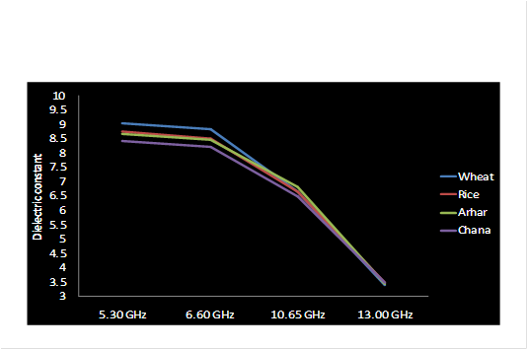
Dielectric Constant for Preliminary samples
Frequencies/samples | Wheat | Rice | Arhar | Chana | Moong
5.30 GHz | 9.037 | 8.7754 | 8.6727 | 8.4098 | 8.8048
6.60 GHz | 8.8451 | 8.5023 | 8.4805 | 8.2315 | 8.5509
10.65 GHz | 6.6643 | 6.6402 | 6.8166 | 6.4729 | 6.3555
13.00 GHz | 3.4142 | 3.4947 | 3.4331 | 3.4903 | 3.3279
[A] For
Dielectric constant

Slide 44
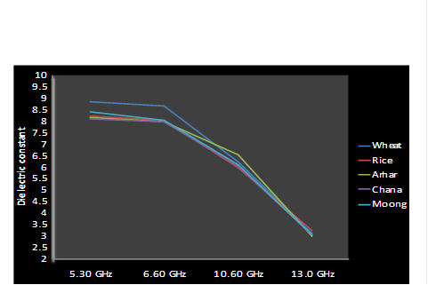
[B] For
Dielectric constant
Dielectric Constant for Oven dried samples
Frequencies/samples | Wheat | Rice | Arhar | Chana | Moong
5.30 GHz | 8.8458 | 8.2015 | 8.1903 | 8.0805 | 8.4429
6.60 GHz | 8.6450 | 8.0509 | 8.0010 | 7.9998 | 8.0521
10.65 GHz | 6.2392 | 6.0010 | 6.5158 | 6.0264 | 6.0853
13.00 GHz | 3.1056 | 3.2350 | 3.0165 | 3.0768 | 3.0527

Slide 45
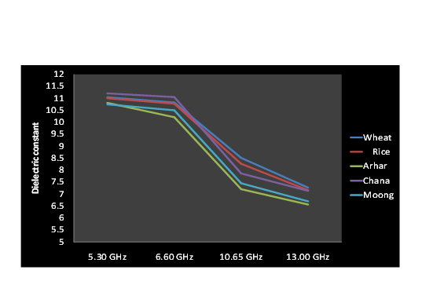
[C] For Dielectric constant
Frequencies/samples | Wheat | Rice | Arhar | Chana | Moong
5.30 GHz | 11.0423 | 11.0012 | 10.8084 | 11.2015 | 10.7458
6.60 GHz | 10.8264 | 10.7765 | 10.2128 | 11.0519 | 10.5023
10.30 GHz | 8.5065 | 8.2617 | 7.2047 | 7.8613 | 7.4480
13.00 GHz | 7.2644 | 7.1625 | 6.5630 | 7.1360 | 6.6974
Dielectric Constant for Saturated samples

Slide 46
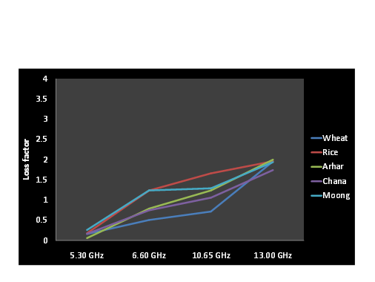
Loss Factor for Preliminary samples
Frequencies/Samples | Wheat | Rice | Arhar | Chana | Moong
5.30 GHz | 0.1591 | 0.1803 | 0.0591 | 0.1625 | 0.2601
6.60 GHz | 0.5056 | 1.2351 | 0.786 | 0.7469 | 1.2365
10.65 GHz | 0.7156 | 1.6594 | 1.2361 | 1.0591 | 1.2907
13.00 GHz | 1.9533 | 1.9603 | 1.9997 | 1.7403 | 1.9389
[A] For Loss Factor

Slide 47
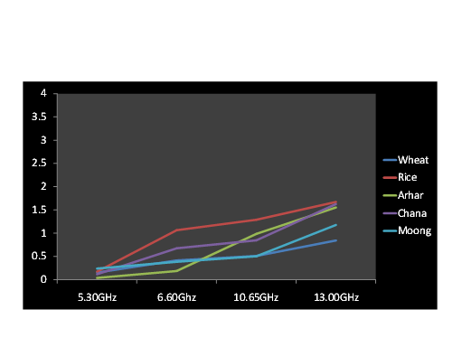
Loss Factor for oven dried samples
Frequencies/samples | Wheat | Rice | Arhar | Chana | Moong
5.30GHz | 0.1527 | 0.1724 | 0.0358 | 0.1166 | 0.2376
6.60Ghz | 0.4132 | 1.0614 | 0.1845 | 0.6726 | 0.383
10.65GHz | 0.5077 | 1.2879 | 0.9827 | 0.8461 | 0.5021
13.00GHz | 0.8423 | 1.6718 | 1.5508 | 1.6259 | 1.1755
[B] For Loss Factor

Slide 48
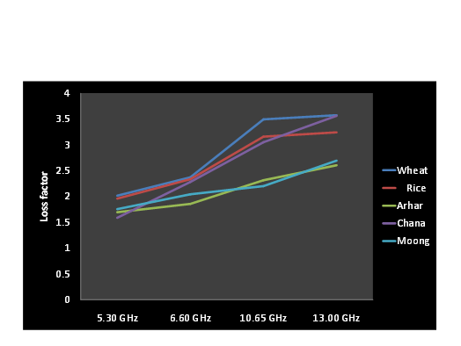
[C] For Loss Factor
Frequencies/samples | Wheat | Rice | Arhar | Chana | Moong
5.30 GHz | 2.0152 | 1.9573 | 1.6955 | 1.5868 | 1.7532
6.60 GHz | 2.3702 | 2.3353 | 1.8566 | 2.2803 | 2.041
10.65 GHz | 3.4927 | 3.1592 | 2.3152 | 3.0519 | 2.2015
13.00 GHz | 3.5736 | 3.243 | 2.6051 | 3.5625 | 2.6927
Loss Factor for Saturated samples

Slide 49
RESULTS
The value of ϵ’ and ϵ” follow a polynomial curve.
The value of ϵ’decreases as frequency increases. (ϵ’↓ f ↑)
The value of ϵ” increases as frequency increases. ( ϵ”↑ f ↑)
The Dielectric Constant of Oven dried samples are least and for Saturated samples are highest. (P<O<S )
The Loss Factors of oven dried samples are highest and for Saturated samples are least. (P>O>S)
The behaviour is observed for all different samples at different frequencies.
Notes:
frequency

Slide 50
Graph on the basis of Moisture Content and their loss factor(є”)
For 20%
For 10%
For 5%
For 2%

Slide 51
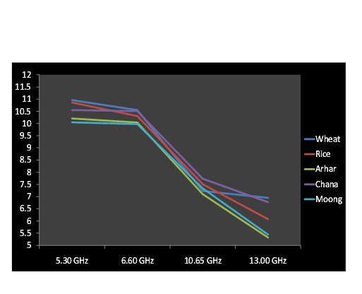
Dielectric Constant for 20% Moisture Content
Frequencies/samples | Wheat | Rice | Arhar | Chana | Moong
5.30 GHz | 10.9652 | 10.862 | 10.2102 | 10.552 | 10.0462
6.60 GHz | 10.5537 | 10.3096 | 10.044 | 10.5118 | 9.9745
10.65 GHz | 7.2349 | 7.5113 | 7.0988 | 7.7321 | 7.341
13.00 GHz | 6.9523 | 6.0729 | 5.3215 | 6.7695 | 5.4407

Slide 52
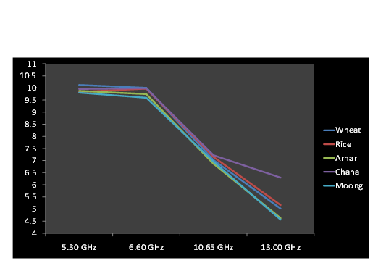
Dielectric Constant for 10% Moisture content
Frequencies/samples | Wheat | Rice | Arhar | Chana | Moong
5.30 GHz | 10.1261 | 9.8401 | 9.8815 | 9.9625 | 9.8091
6.60 GHz | 10.0115 | 9.9737 | 9.7513 | 9.988 | 9.5967
10.65 GHz | 7.02804 | 7.1579 | 6.8751 | 7.2216 | 6.9611
13.00 GHz | 5.0215 | 5.162 | 4.6231 | 6.2963 | 4.5621

Slide 53
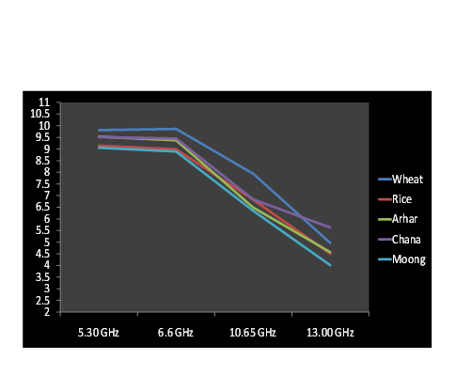
Dielectric Constant for 5% Moisture Content
Frequencies/samples | Wheat | Rice | Arhar | Chana | Moong
5.30 GHz | 9.8105 | 9.1456 | 9.5325 | 9.5119 | 9.0552
6.6 GHz | 9.862 | 8.9872 | 9.3705 | 9.4492 | 8.8903
10.65 GHz | 7.9403 | 6.8216 | 6.4856 | 6.831 | 6.3457
13.00 GHz | 4.9619 | 4.5009 | 4.5698 | 5.6257 | 4.0057

Slide 54
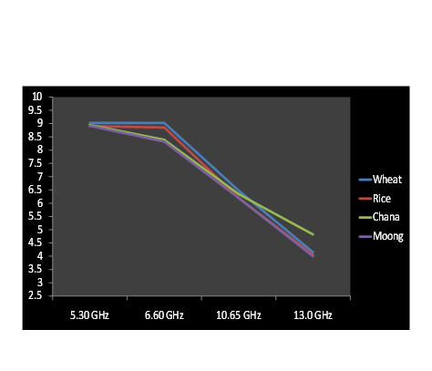
Dielectric Constant for 2% Moisture Content
Frequencies/Samples | Wheat | Rice | Arhar | Chana | Moong
5.30 GHz | 9.0255 | 8.9112 | 9.0856 | 8.9456 | 8.9196
6.60 GHz | 9.0255 | 8.8562 | 8.2975 | 8.3864 | 8.3203
10.65 GHz | 6.4713 | 6.1925 | 6.0111 | 6.3419 | 6.1928
13.0 GHz | 4.1477 | 4.0502 | 3.9826 | 4.8206 | 3.9905

Slide 55
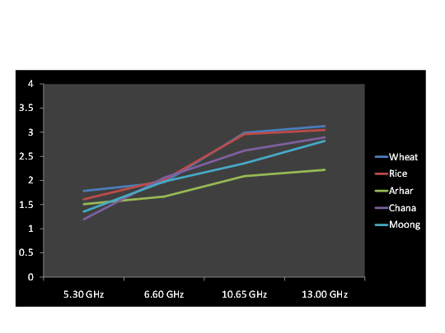
Loss Factor for 20%
Moisture Content
Frequencies/Samples | Wheat | Rice | Arhar | Chana | Moong
5.30 GHz | 1.7851 | 1.6123 | 1.5103 | 1.1961 | 1.3577
6.60 GHz | 1.9614 | 2.0115 | 1.6679 | 2.0573 | 1.9764
10.65 GHz | 2.9903 | 2.9621 | 2.0915 | 2.6214 | 2.3551
13.00 GHz | 3.1287 | 3.0488 | 2.2209 | 2.8941 | 2.8201

Slide 56
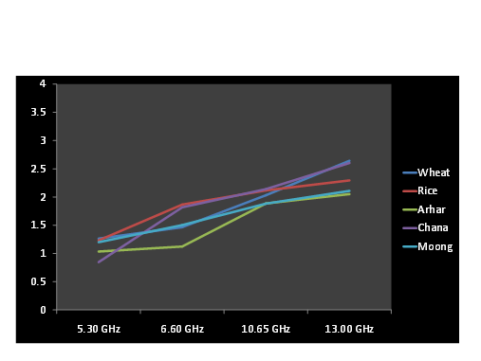
Loss Factor for
10%
Moisture Content
Frequencies/Samples | Wheat | Rice | Arhar | Chana | Moong
5.30 GHz | 1.2613 | 1.2305 | 1.0325 | 0.8462 | 1.1985
6.60 GHz | 1.465 | 1.8644 | 1.1213 | 1.8154 | 1.5028
10.65 GHz | 2.0321 | 2.1156 | 1.8854 | 2.1392 | 1.8816
13.00 GHz | 2.642 | 2.2946 | 2.0512 | 2.6031 | 2.1078

Slide 57
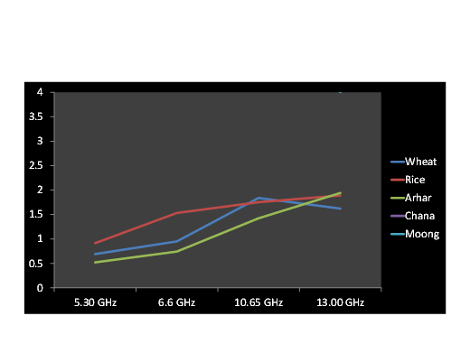
Loss Factor for 5% Moisture Content
Frequencies/Samples | Wheat | Rice | Arhar | Chana | Moong
5.30 GHz | 0.6933 | 0.9156 | 0.5213 | 9.5119 | 9.0552
6.6 GHz | 0.9523 | 1.5319 | 0.7428 | 9.4492 | 8.8903
10.65 GHz | 1.8406 | 1.7553 | 1.4261 | 6.831 | 6.3457
13.00 GHz | 1.6231 | 1.8932 | 1.9418 | 5.6257 | 4.0057

Slide 58
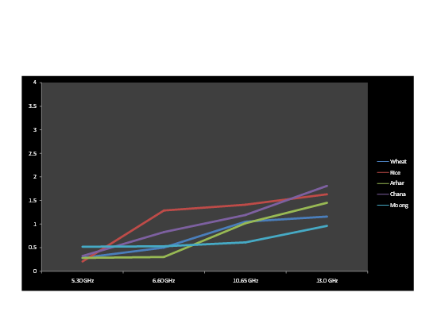
Loss Factor for 2% Moisture Content
Frequencies/Samples | Wheat | Rice | Arhar | Chana | Moong
5.30 GHz | 0.2832 | 0.2059 | 0.2856 | 0.3251 | .5194
6.60 GHz | 0.5017 | 1.2886 | 0.3012 | 0.8305 | .5298
10.65 GHz | 1.0521 | 1.4125 | 1.0196 | 1.1924 | .6128
13.00 GHz | 1.1589 | 1.6319 | 1.4512 | 1.8119 | .9630

Slide 59

THANK-YOU

Slide 60

QUEREIES????

